Slide 1
Exercise 5.4 Differential equation
An equation involving the derivative of dependent variable with respect to independent variable is known as differential equation. A differential equation takes an infinite number of infinitesimal steps. For differential equations du/dt=Au, the solution u(t) = e^{At}u(0) depends on the exponential of A.

Slide 2

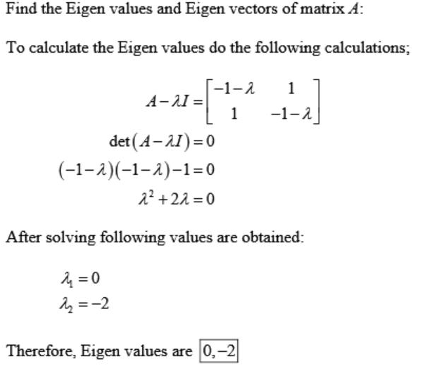
Question 1 (solution)
Following the first example in this section, find the eigen values and eigenvectors,
and the exponential e^{At} , for

Slide 3
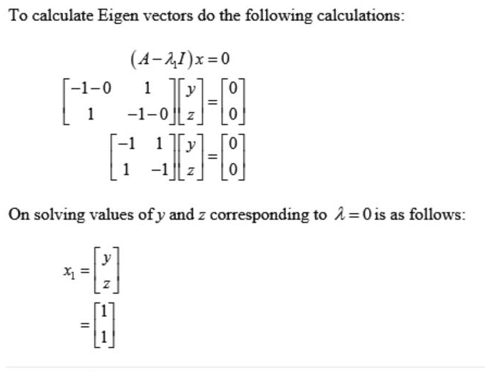

Slide 4
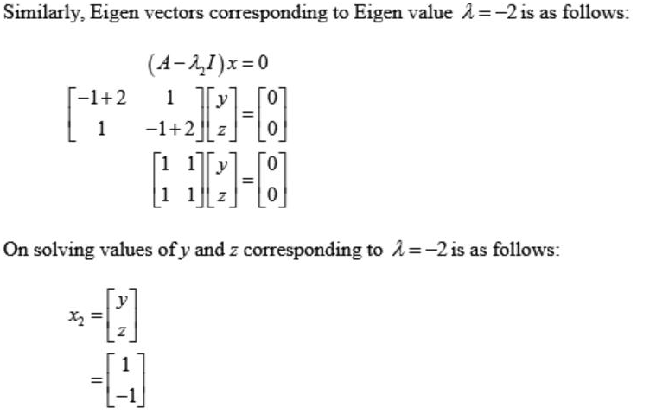

Slide 5

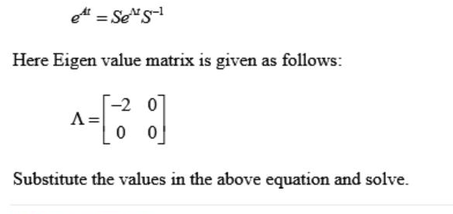
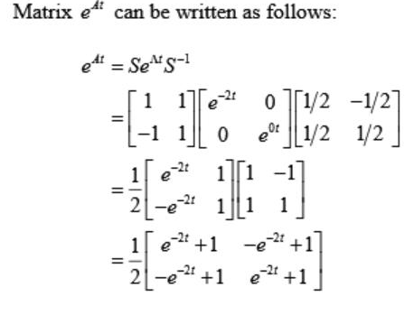

Slide 6
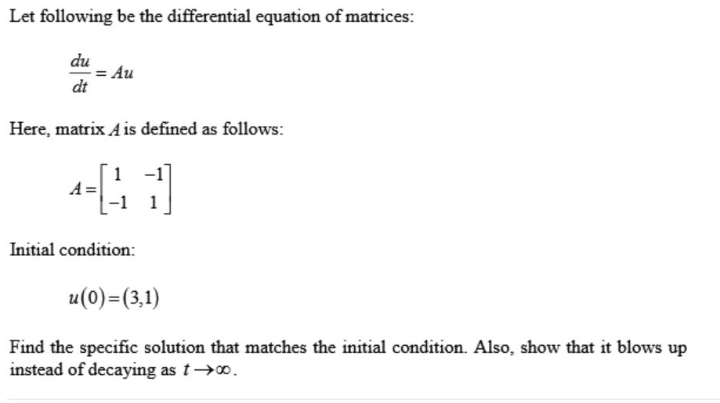
Question 2

Slide 7
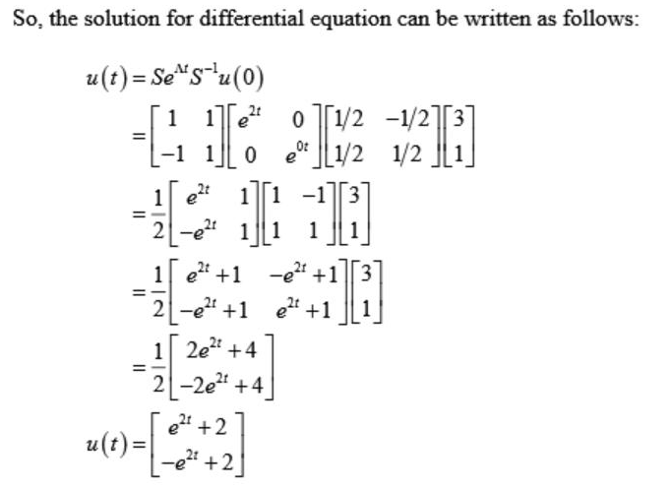
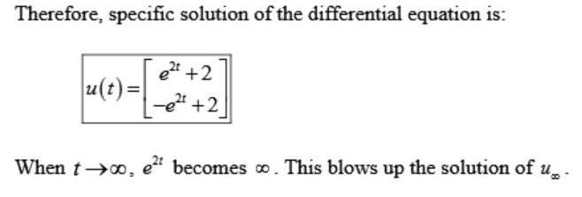

Slide 8
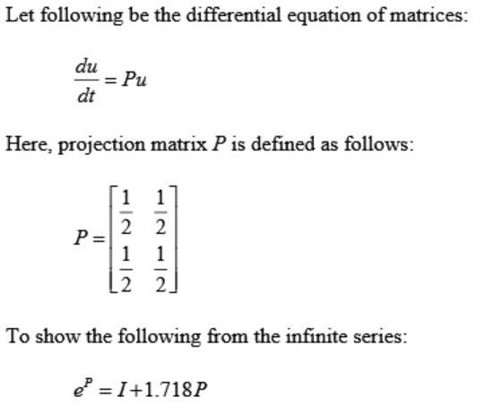
Question 4

Slide 9
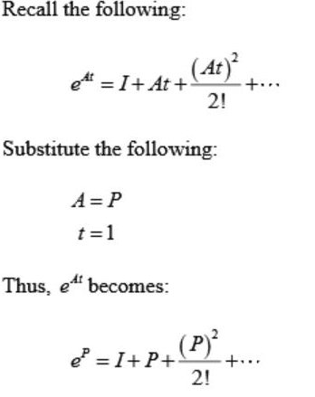
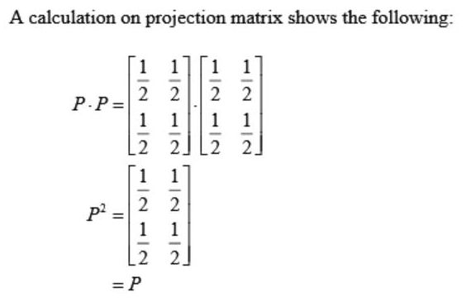
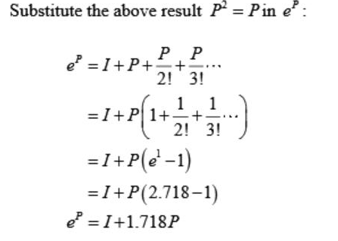

Slide 10
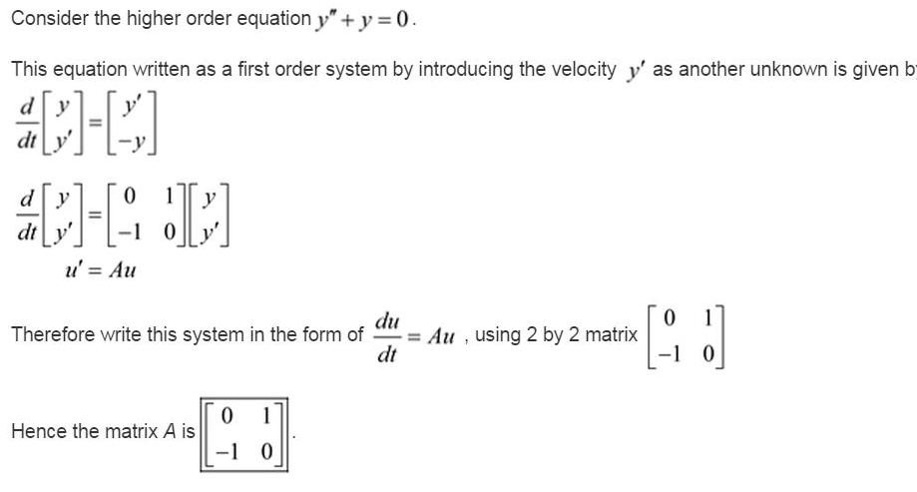
Problem 6

Slide 11
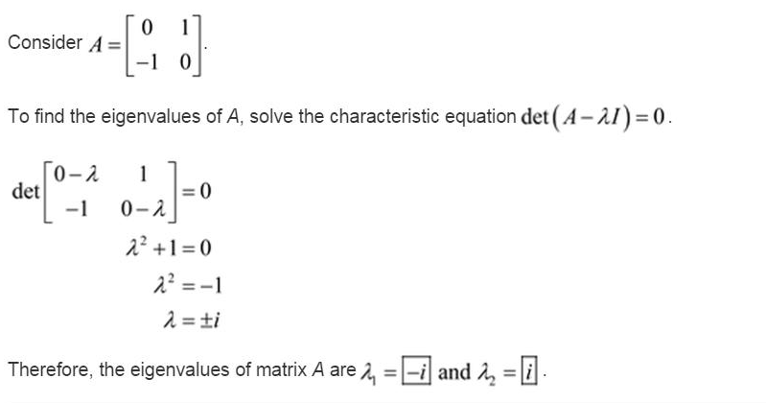

Slide 12
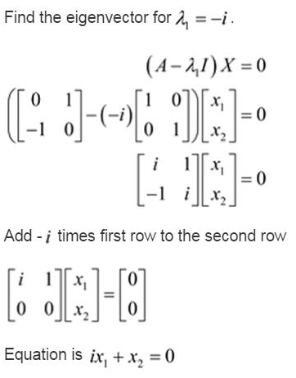

Slide 13

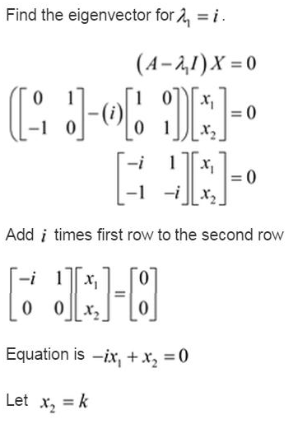

Slide 14

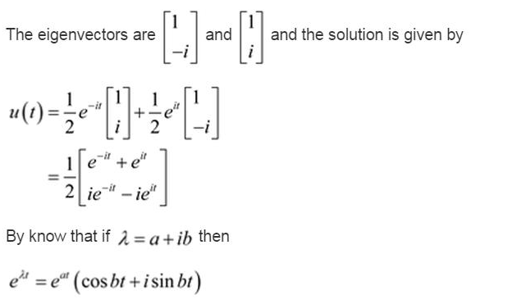

Slide 15
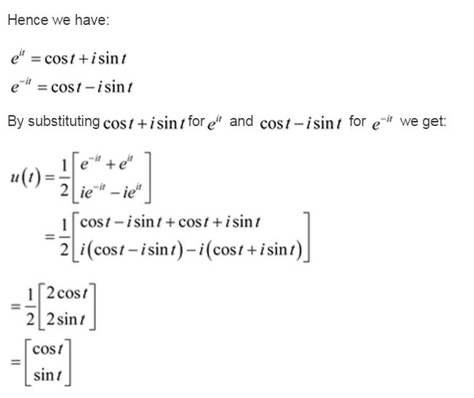

Slide 16
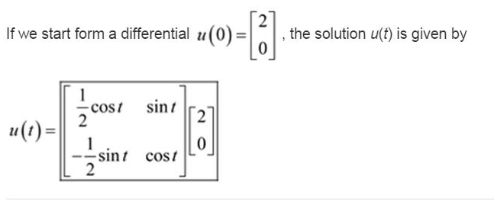
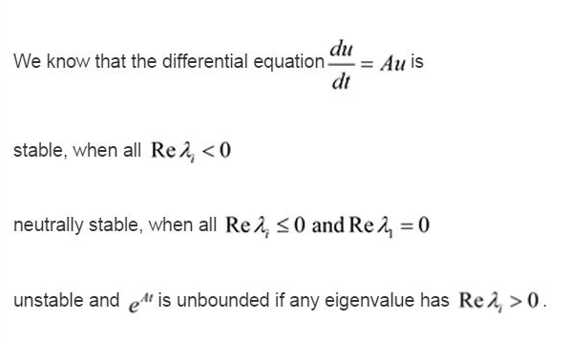

Slide 17
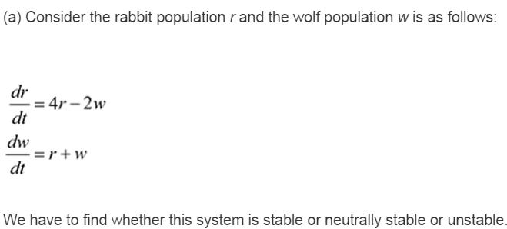
Question 8

Slide 18
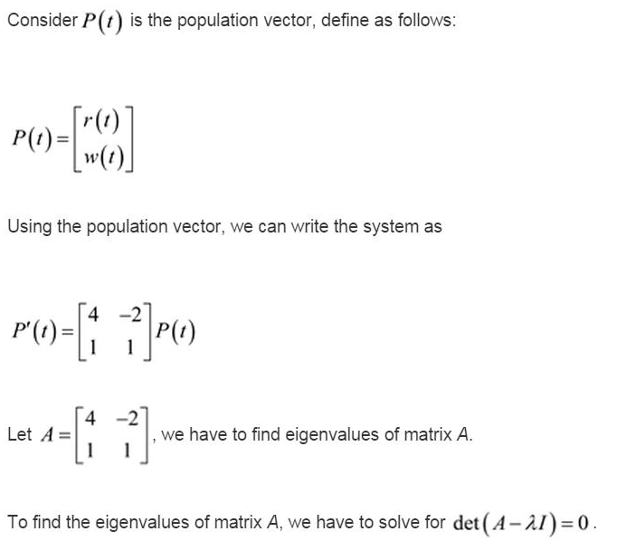

Slide 19
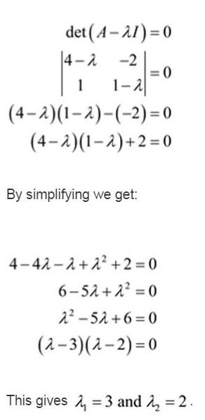

Slide 20

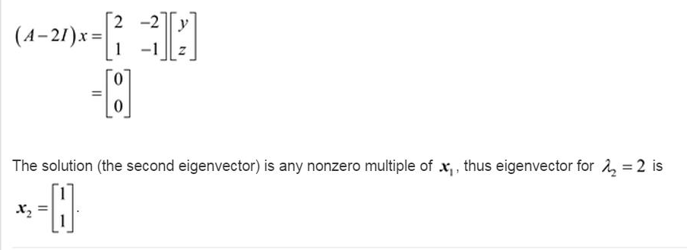

Slide 21
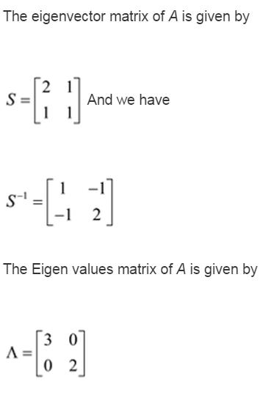
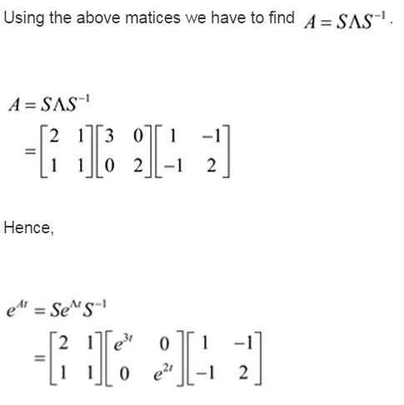

Slide 22
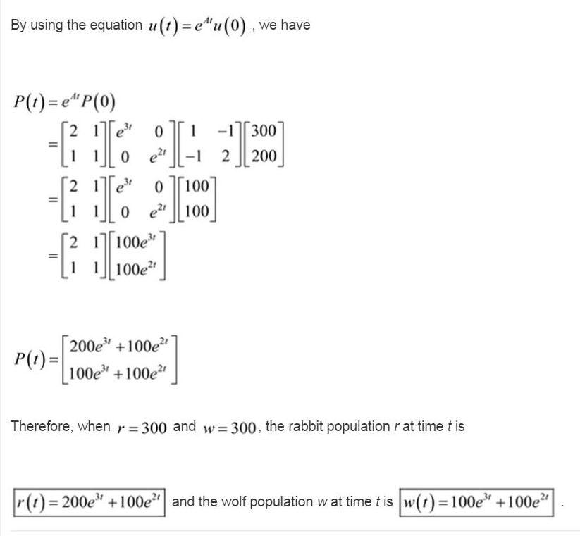

Slide 23
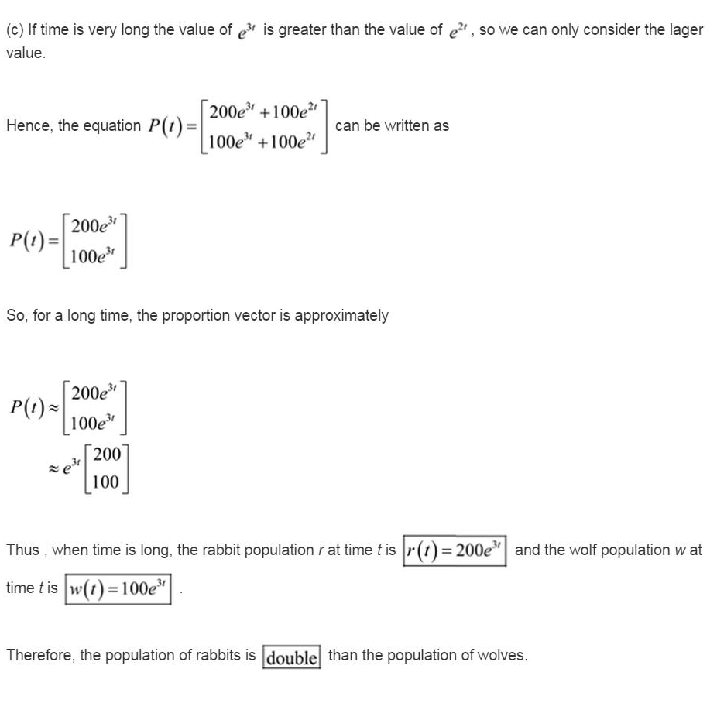

Slide 24

du/dt=Au implies that du/u=Adt integrating, we have lnu=At+C1 taking exponential function, we have e^{lnu}=e^{At+C1} implies that u=e^{AT}.e^{C1} =e^{At}u₀ e^{At}=S S⁻¹

Slide 25
dv/dt=w dw/dt=v

